Slide 1

Heart Disease Prediction
System
A Production-Ready Machine Learning Web Application
Predicting Heart Disease Risk Using XGBoost | FastAPI | MongoDB | Vercel

Slide 2
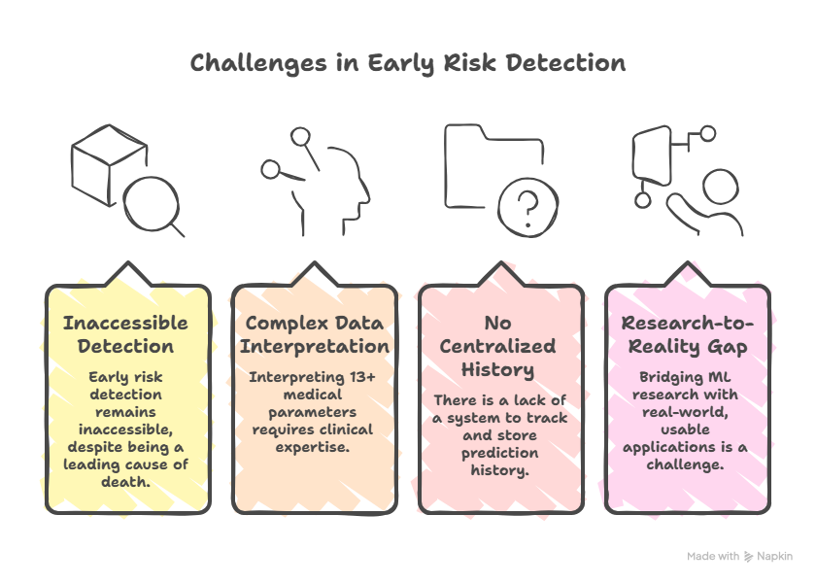
The Problem We're Solving
Our motivation: Build a production-ready app that provides instant, data-driven heart risk assessments from anywhere, on any device.

Slide 3
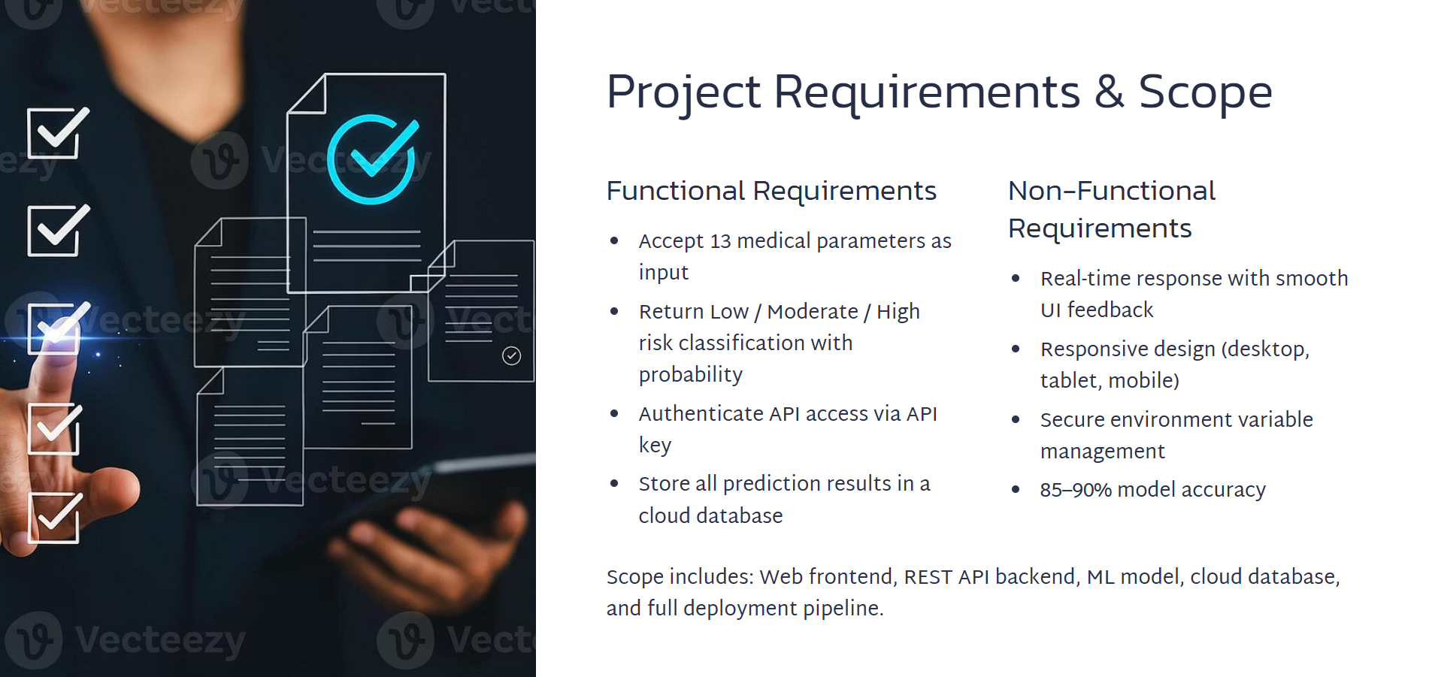
Project Requirements & Scope
Functional Requirements
Non-Functional Requirements
Real-time response with smooth UI feedback
Responsive design (desktop, tablet, mobile)
Secure environment variable management
85–90% model accuracy
Scope includes: Web frontend, REST API backend, ML model, cloud database, and full deployment pipeline.

Slide 4
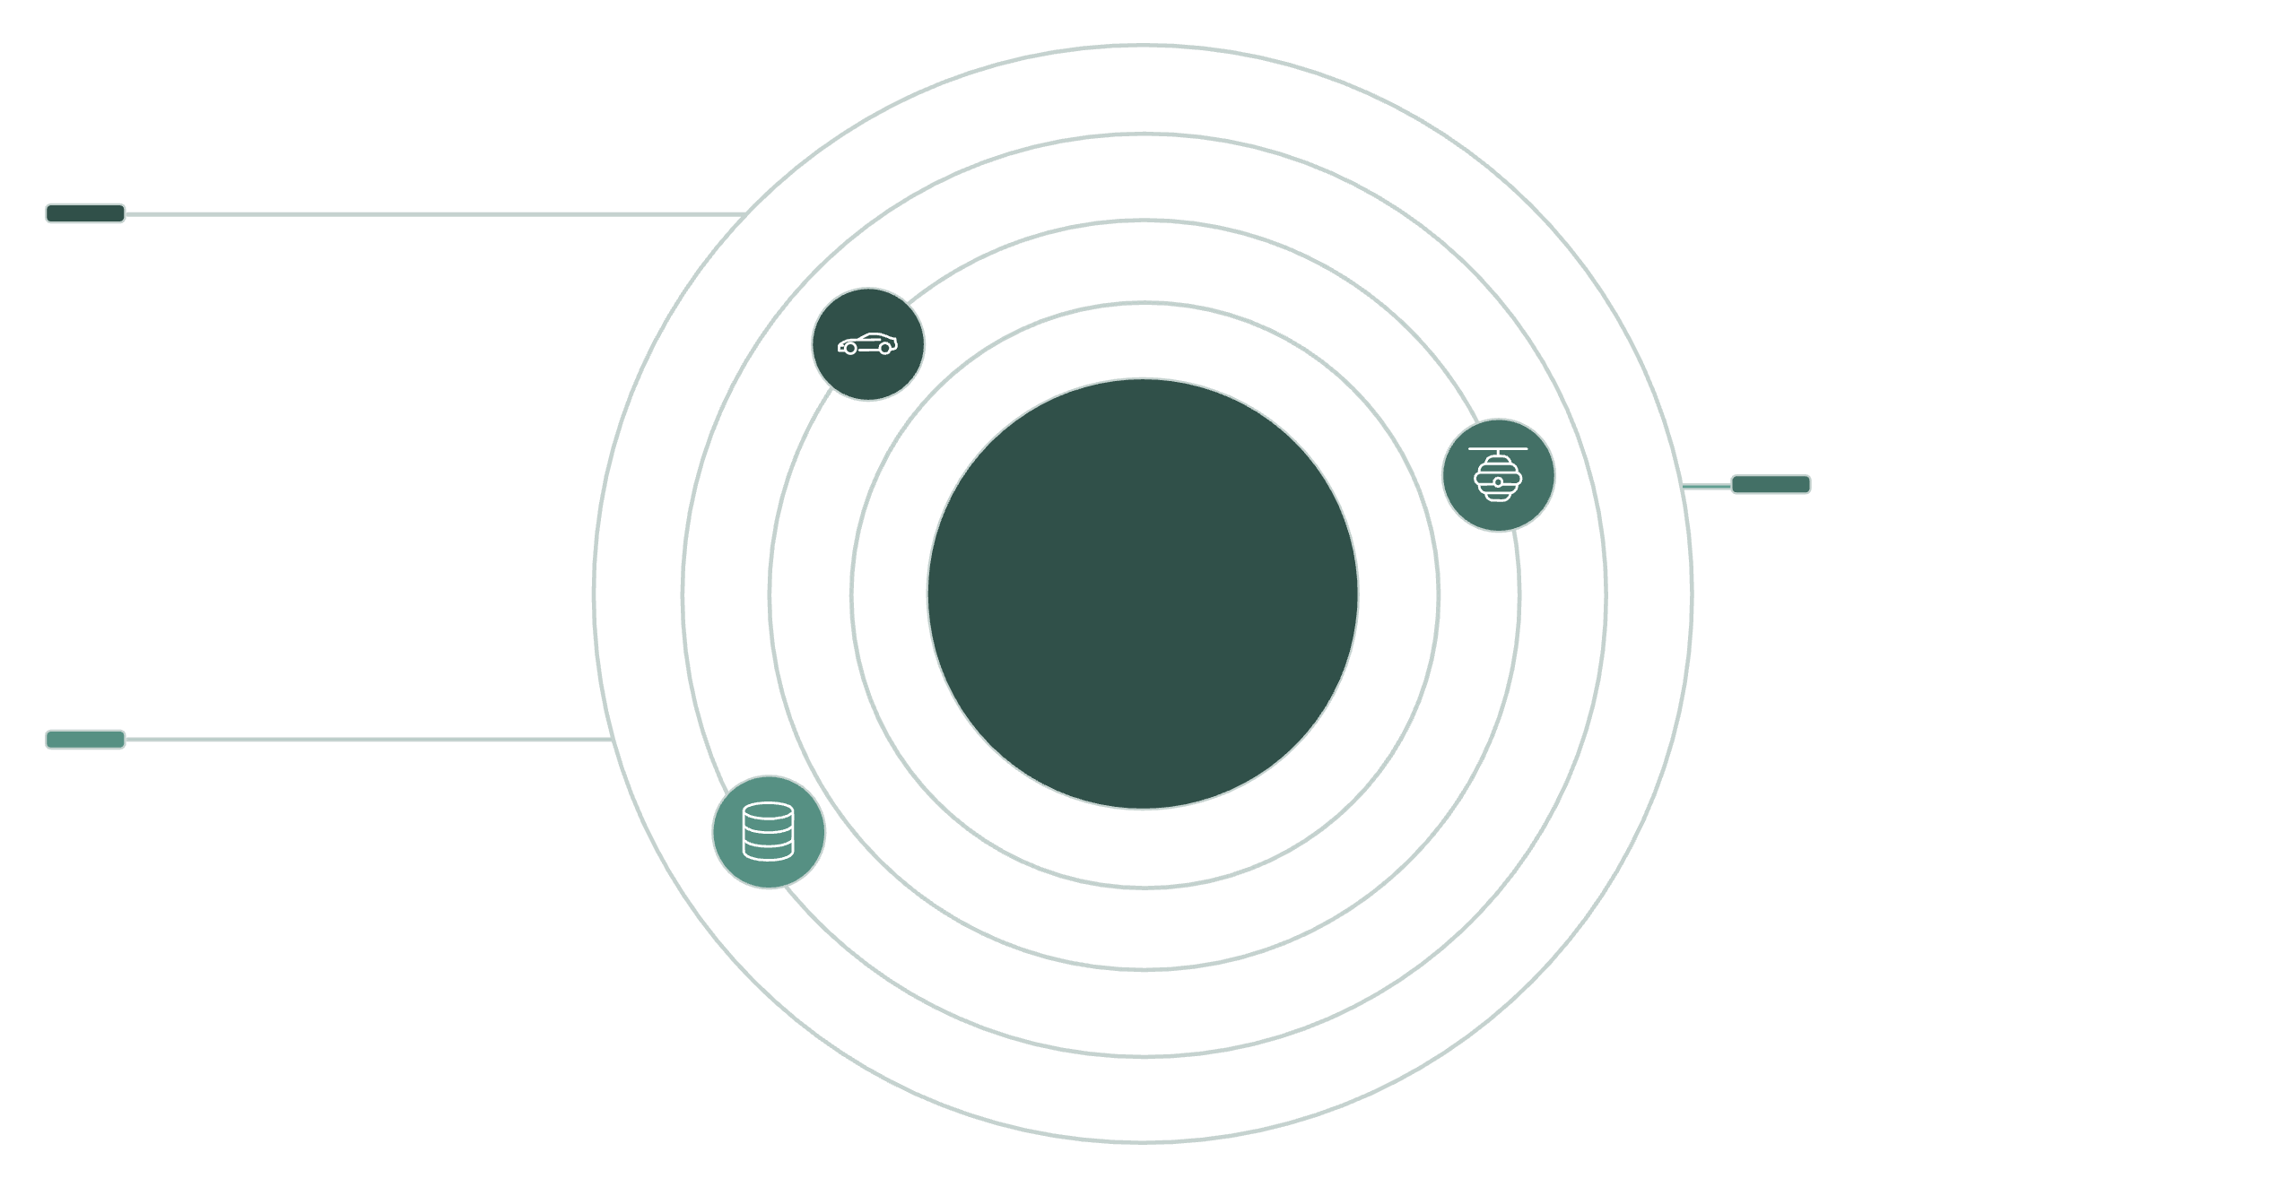



How We Built It: Technology Stack
Web Frontend
Vercel-hosted HTML/CSS/JS frontend
Three-Tier Cloud Architecture
FastAPI Backend
Railway-deployed API with Uvicorn
MongoDB Atlas
Managed cloud database for data storage
Core Technologies
Key Design Decisions
Backend: FastAPI, XGBoost, MongoDB, Pydantic, Uvicorn, Python 3.9+
Frontend: HTML5, CSS3, JavaScript (ES6+), Fetch API
Deployment: Railway (backend), Vercel (frontend), MongoDB Atlas (database), GitHub
ML Pipeline: scikit-learn, pandas, numpy
XGBoost: High performance for tabular medical data.
FastAPI: Async, high-speed API responses.
MongoDB: Flexible, schema-free prediction storage.

Slide 5
Project Planning & Execution
01
02
Data Collection & Preprocessing
Model Training
Cleaned Cleveland Heart Disease Dataset (cleaned_heart.csv).
XGBoost classifier training and evaluation.
03
04
Backend Development
Frontend Development
FastAPI app with prediction endpoint, API key auth, MongoDB integration.
Responsive UI, form validation, loading animations, result visualization.
05
06
Cloud Deployment
Testing & Validation
Railway (backend), Vercel (frontend), MongoDB Atlas (database).
Input range validation, API testing, cross-browser UI checks.

Slide 6
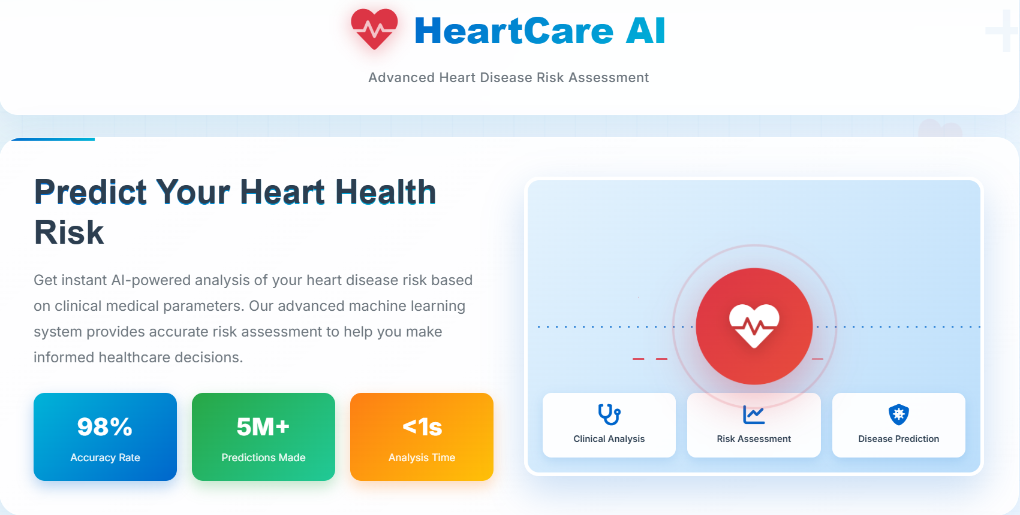
Live Demo & Results
What Was Achieved
Model Performance
Fully deployed, production-ready application.
Frontend on Vercel | Backend API on Railway | Data in MongoDB Atlas.
Algorithm: XGBoost Classifier
Training Data: Cleveland Heart Disease Dataset
Accuracy: ~85–90%
Output: Risk probability (0.0–1.0) + Risk level
API in Action: POST /api/predict
UX Highlights
Input: 13 medical parameters
Color-coded risk results with progress bars
Real-time form validation and error handling
Seamless mobile and desktop experience
Output: { "risk_probability": 0.87, "risk_level": "High" }

Slide 7


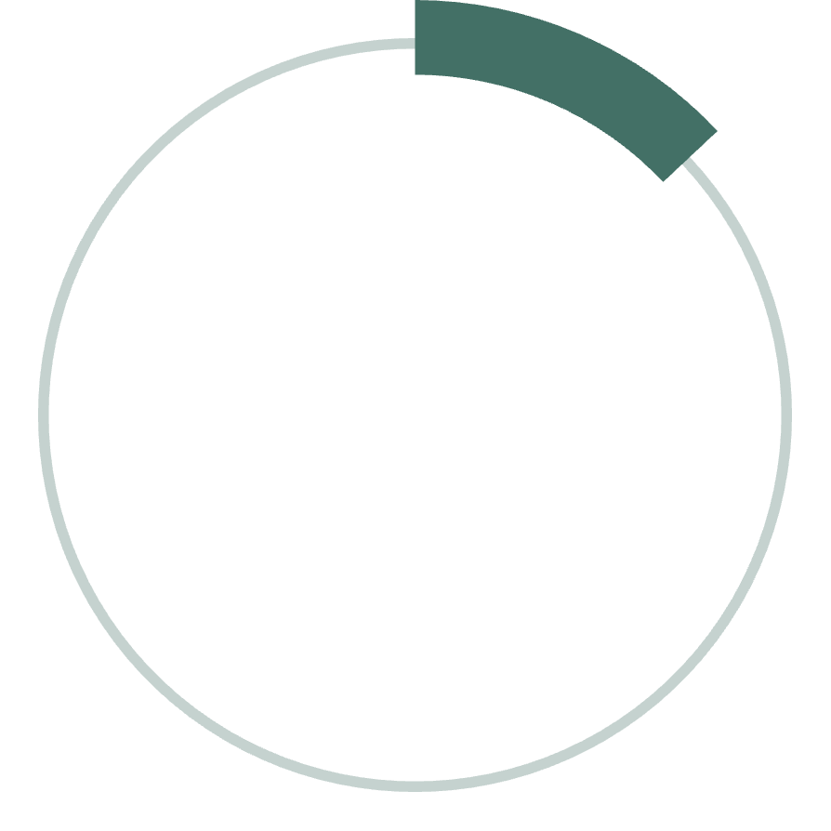
Deployment & Model Accuracy
85-90%
100%
13
Prediction Accuracy
Production Deployment
Medical Parameters
Achieved with XGBoost on Cleveland Heart Disease Dataset.
Live on Vercel, Railway, and MongoDB Atlas.
Key inputs for comprehensive risk assessment.

Slide 8
Thank You — Questions Welcome!
"Early prediction saves lives — technology makes it possible."
Summary Recap
Complete ML-powered heart disease prediction system.
Deployed across 3 cloud platforms.
85–90% prediction accuracy using XGBoost.
Designed for real-world usability with security, validation, and responsive UI.
Open Source: Available under the MIT License
Built with ❤️ for healthcare and machine learning education.

